Slide 1




02 March 2026
Econet Website Monthly Report Analysis

Slide 2


02 March 2026
This report aims to analyze the website's performance for March 2026, focusing on traffic, user flow, traffic sources, demographics, behaviors, and security.
What Is The Purpose Of This Report?
Key metrics
Traffic overview
Audience demographics
Behavior analysis
Acquisition channels
Conversion tracking
Areas Of Focus:

Slide 3

Summary
Performance of the website based on data insights
In the past month, the Econet Wireless Website attracted a total of 34K active users, with 32K being new and 5,9K returning users, these are people who visited the website multiple times. The majority of users accessed the site through organic search (15,6K users), while smaller numbers came via Paid Social (4K). Zimbabwe contributed the highest traffic, with 29K users. On average, users engaged with the site for 47s seconds per session.

Slide 4
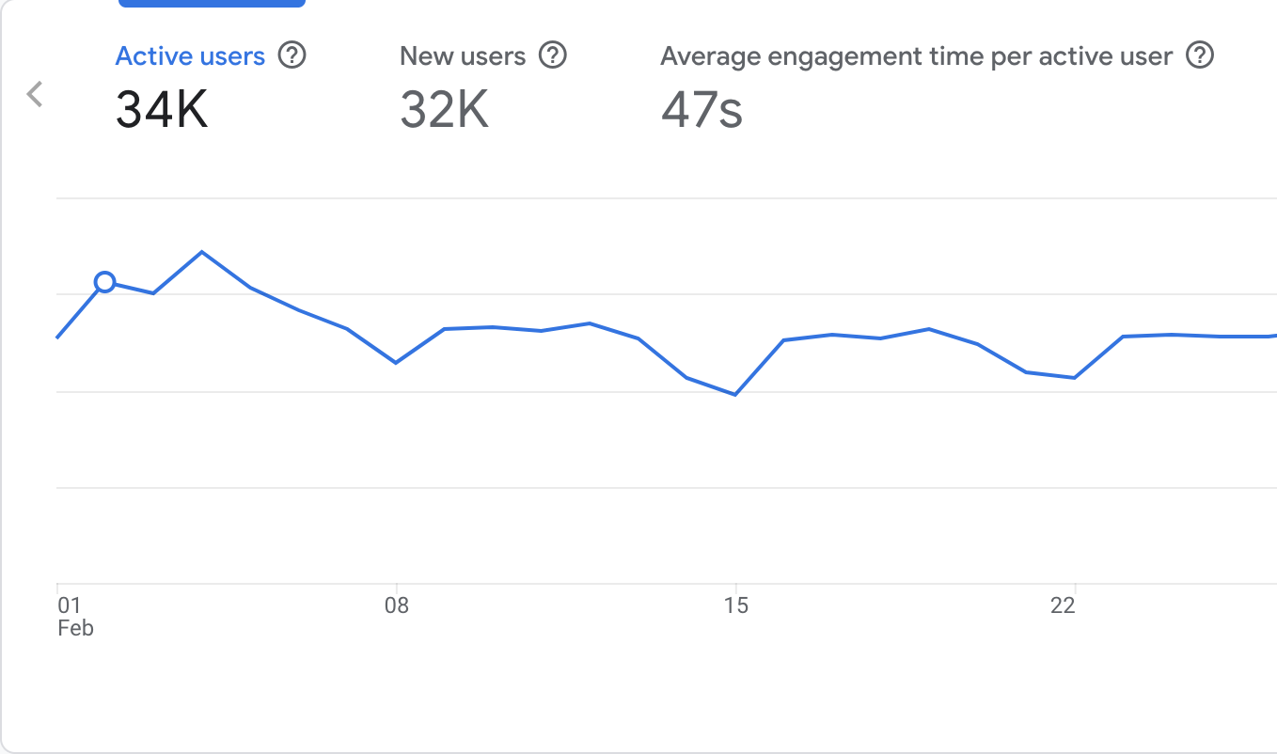
Site Overview
Emphasizing the important numerical data, the large line chart on the right displays the key metrics for the Econet website from the previous month.
It shows:
Users : 34K total users visited the site.
New Users : 32K new users, indicating most visitors were first-time visitors.
Average Engagement Time : Users spent an average of 47s seconds on the site.

Slide 5
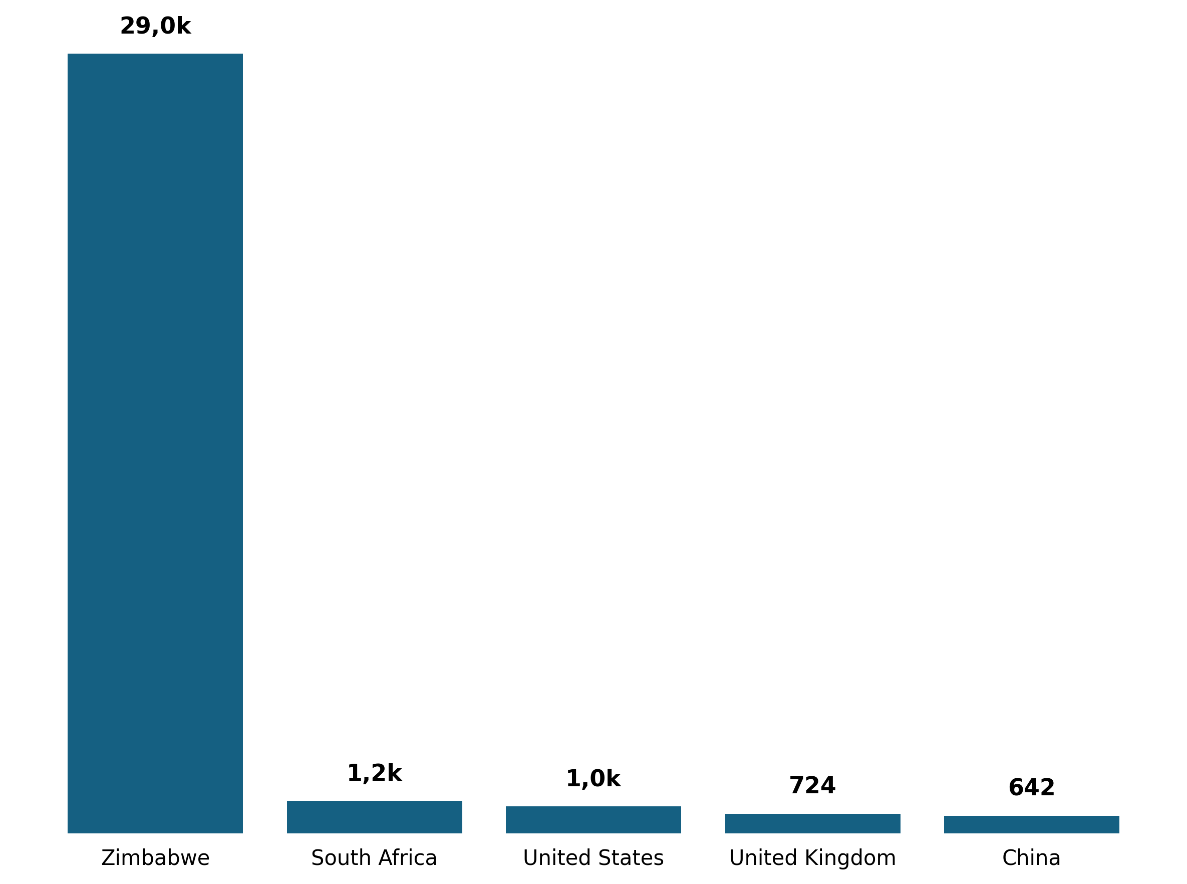
Demographic Overview
Most of the traffic is coming from Zimbabwe(29K users) , followed by South Africa with (1,2K users) then United States with (1K users) and United Kingdom with (724 users) each.

Slide 6
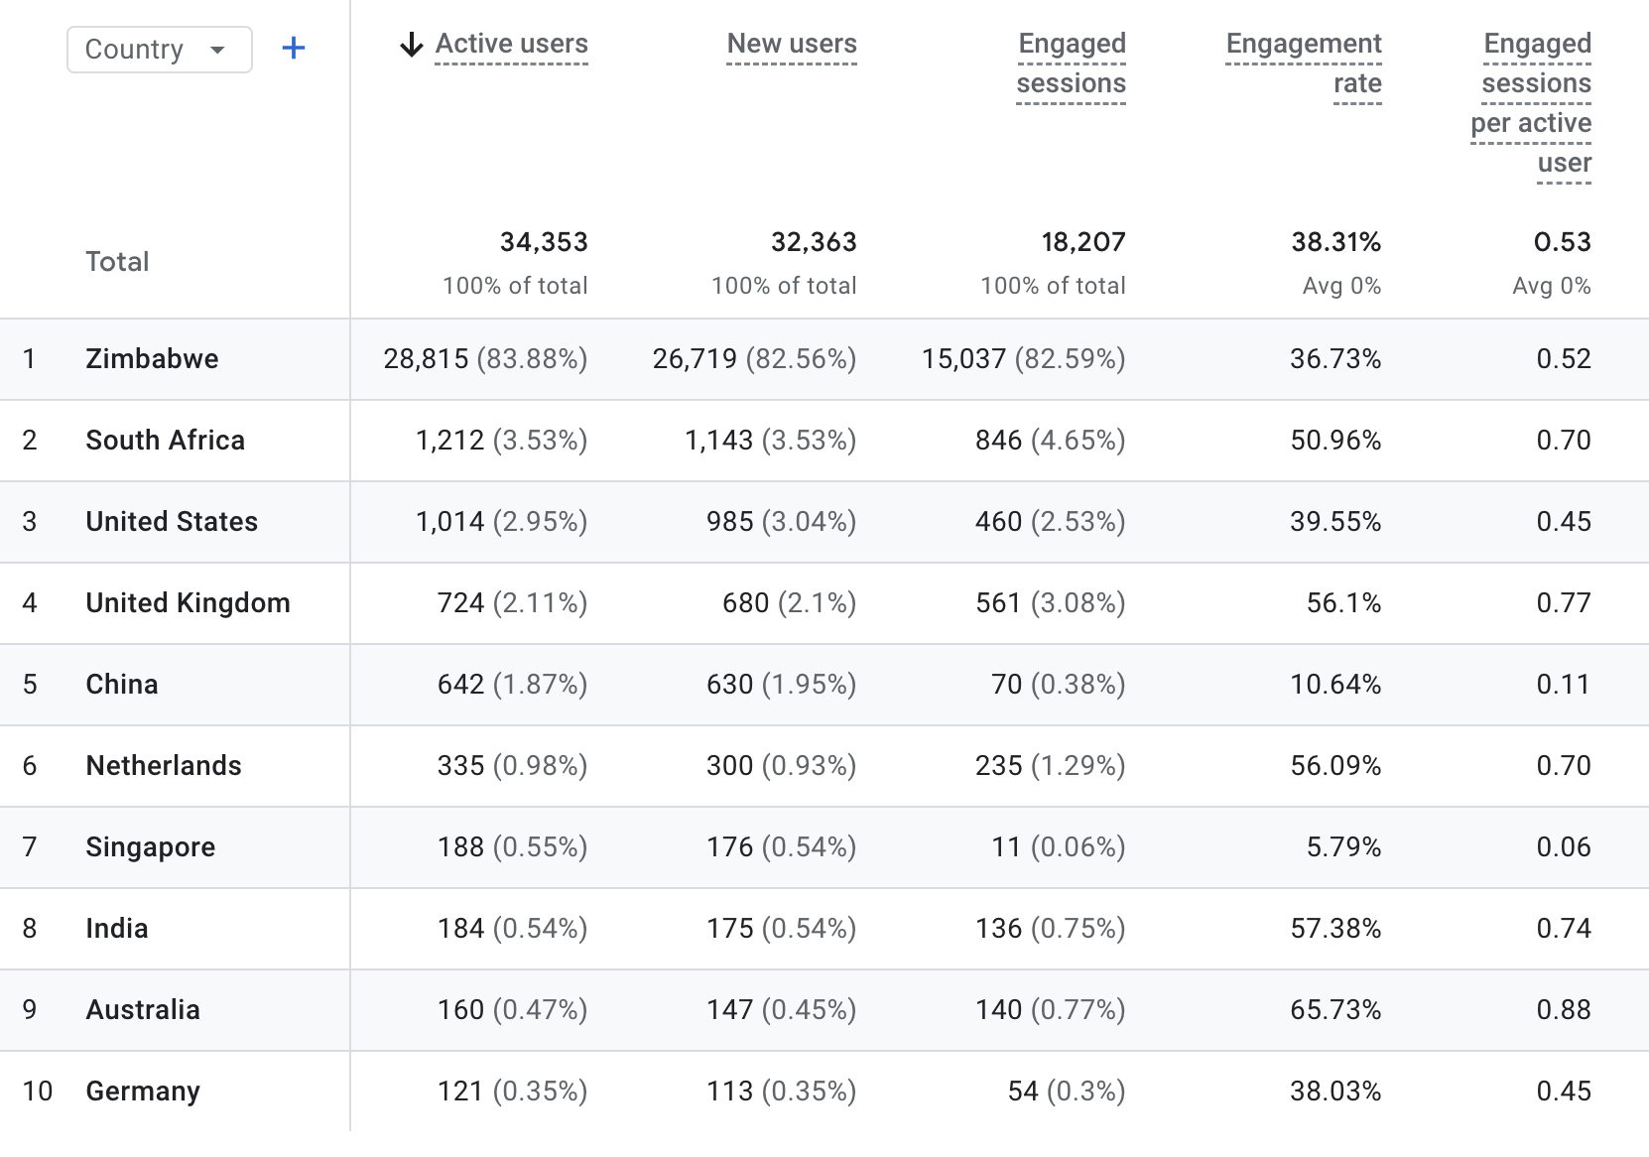
Demographic Overview

Slide 7
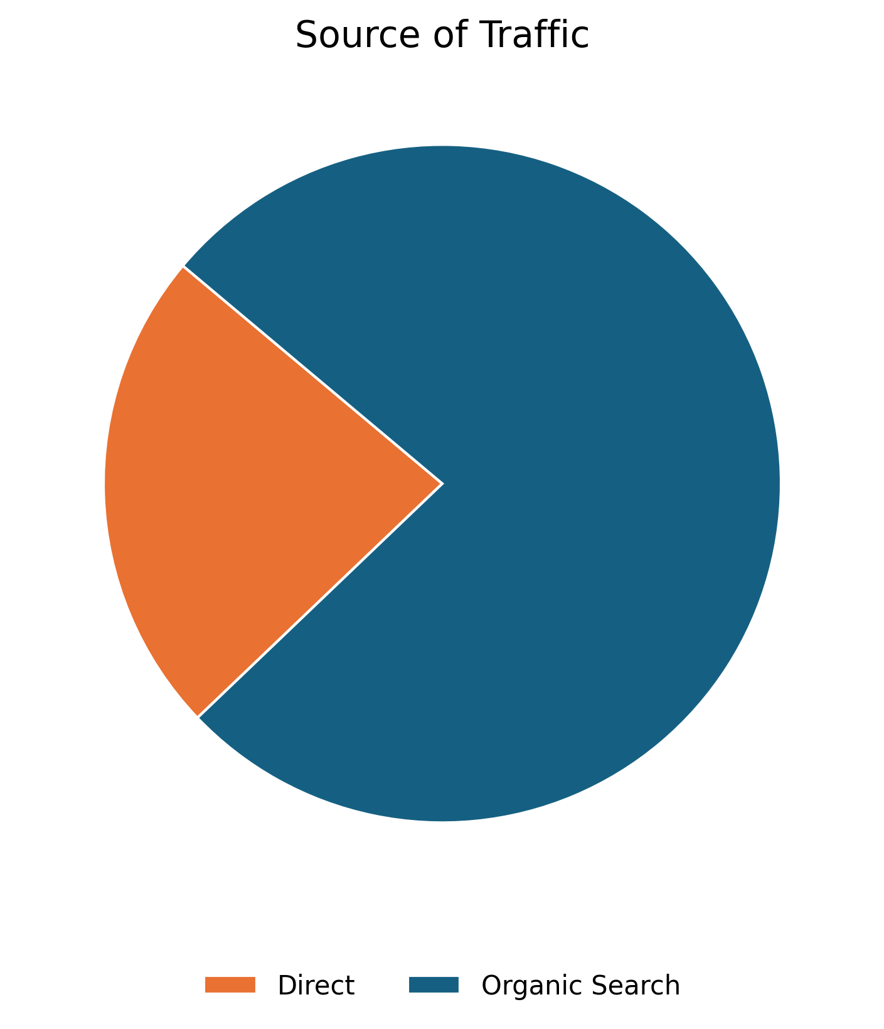
01 July 2025
User Acquisition
The data on this slide illustrates the various traffic channels bringing users to the Econet website. The pie chart reveals that the majority of traffic comes from Organic Search, which refers to unpaid search engine results generated based on their relevance to the user's query.
Source | Users
Organic Search | 15,650
Direct | 4,741

Slide 8
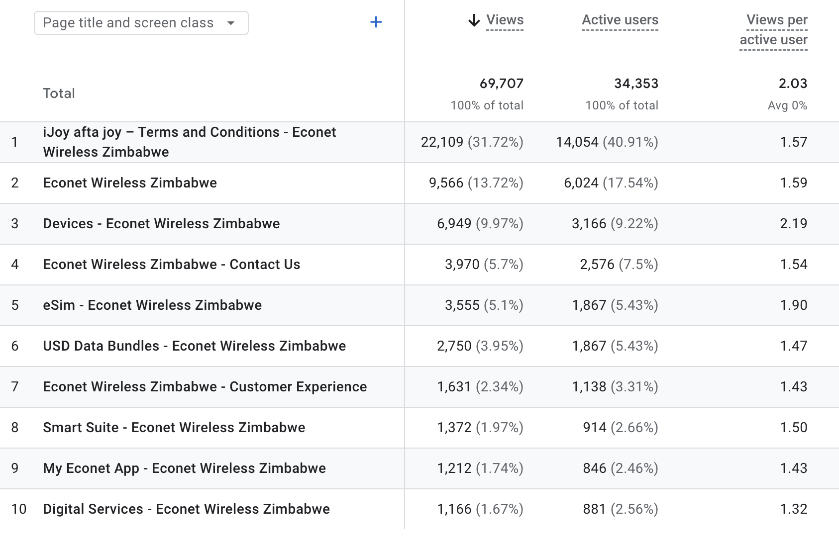

Pages Sessions
The table shows the top pages visited by users in the previous month

Slide 9
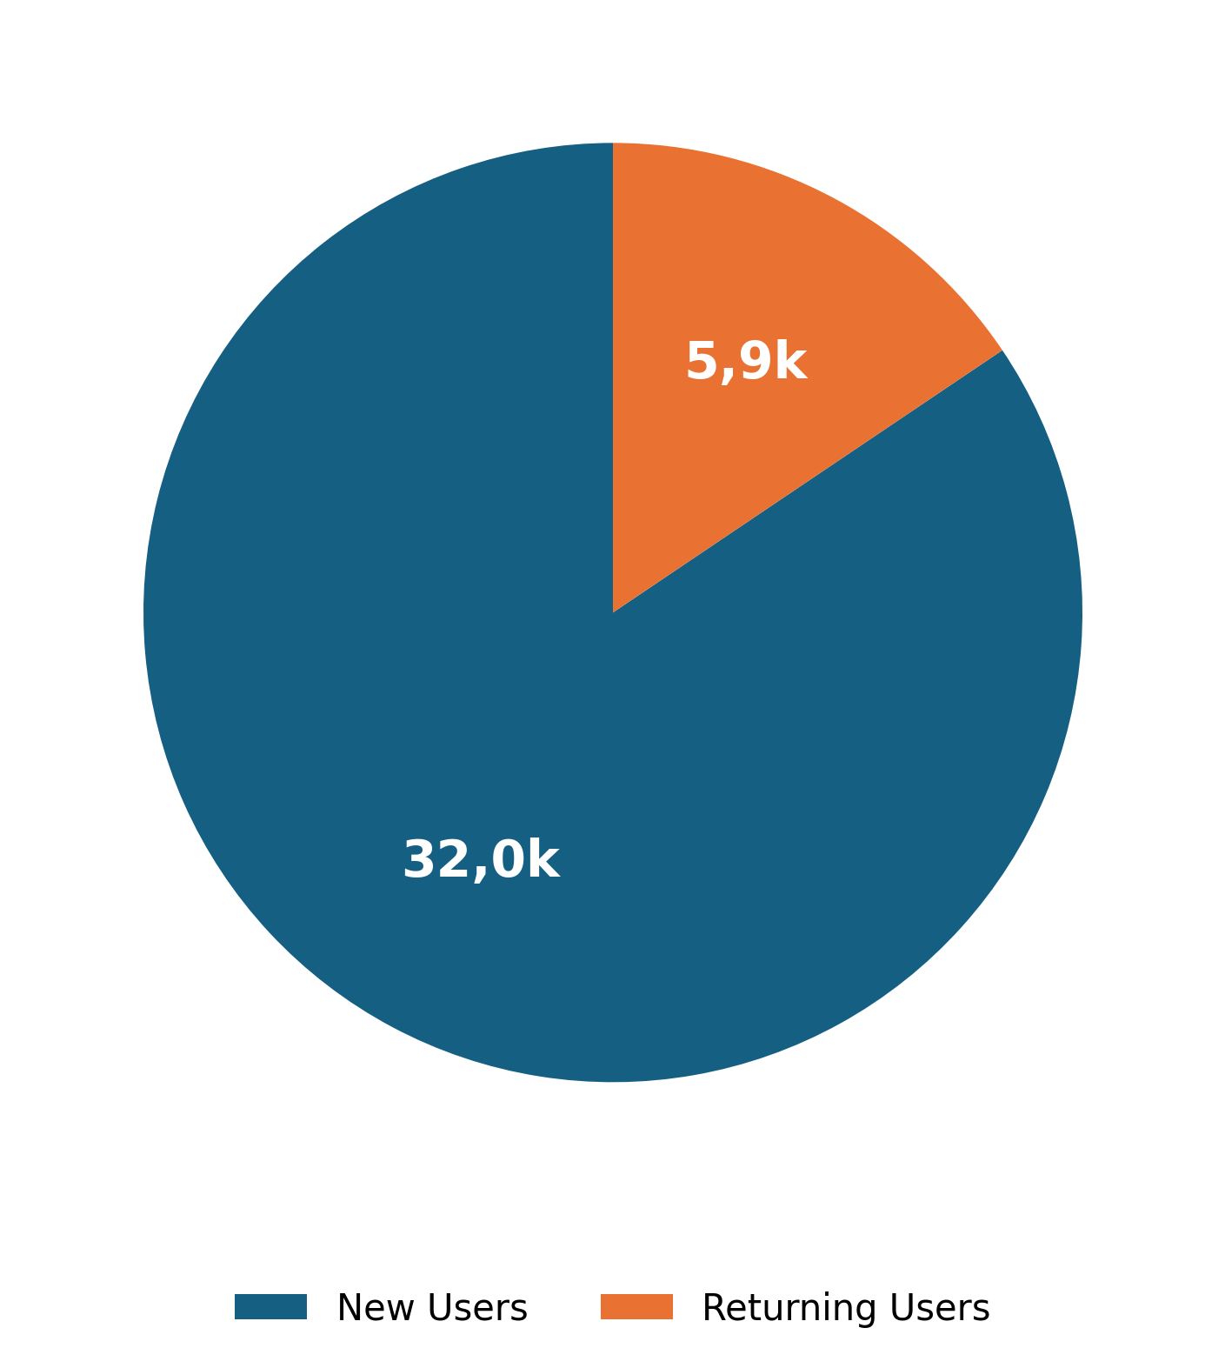
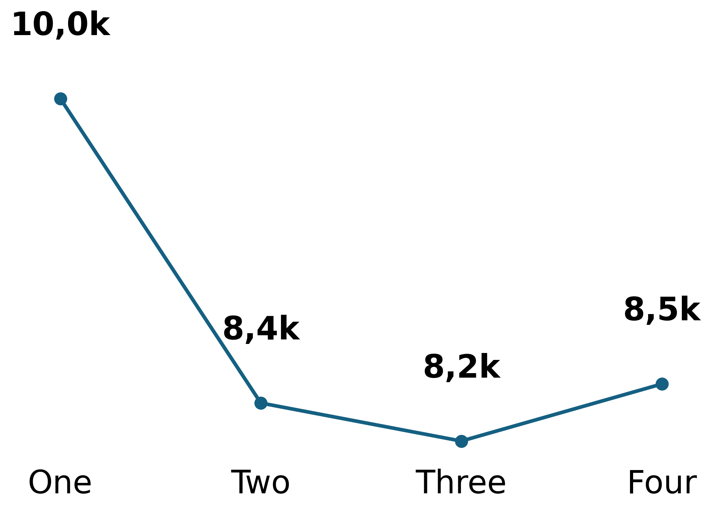
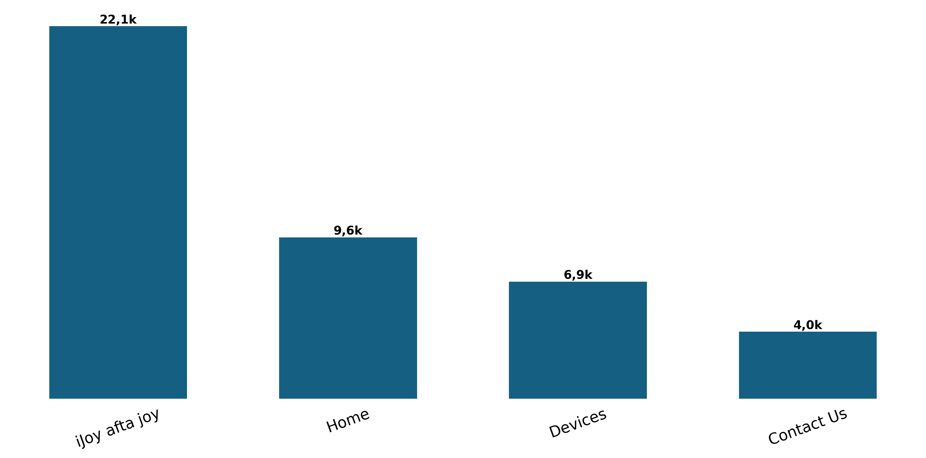
Behavior Analysis
Users
Engagement Rate Per Week
Page Views
Based on user interactions.
Measure user interaction.
Track page visits.

Slide 10

Recommendations
Based on data insights
1. Enhance User Engagement: Integrate seasonal promotional banners and interactive content directly onto the ijoy afta joy and Home pages.
2. Increase Returning Users: Launch a re-engagement campaign targeting the 32,000 new visitors with "exclusive-to-web" offers or personalized updates.
3. Increase Active Users: Implement prominent navigation buttons and call-to-action links to Econet AI and Econet InfraCo on high-traffic utility pages.

